Slide 1
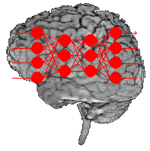
Artificial Neural Networks

Slide 2
Agenda
What is an Artificial Neural Networks?
How it works?
Learning
Learning paradigms
Supervised learning
Unsupervised learning
Reinforcement learning
Applications areas
Advantages and Disadvantages

Slide 3
Artificial Neural Network
An artificial neural network consists of a pool of simple processing units which communicate by sending signals to each other over a large number of weighted connections.

Slide 4
Artificial Neural Network
A set of major aspects of a parallel distributed model include:
a set of processing units (cells).
a state of activation for every unit, which equivalent to the output of the unit.
connections between the units. Generally each connection is defined by a weight.
a propagation rule, which determines the effective input of a unit from its external inputs.
an activation function, which determines the new level of activation based on the effective input and the current activation.
an external input for each unit.
a method for information gathering (the learning rule).
an environment within which the system must operate, providing input signals and _ if necessary _ error signals.

Slide 5
Computers vs. Neural Networks
“Standard” Computers Neural Networks
one CPU highly parallel processing
fast processing units slow processing units
reliable units unreliable units
static infrastructure dynamic infrastructure

Slide 6
Why Artificial Neural Networks?
There are two basic reasons why we are interested in building artificial neural networks (ANNs):
Technical viewpoint: Some problems such as character recognition or the prediction of future states of a system require massively parallel and adaptive processing.
Biological viewpoint: ANNs can be used to replicate and simulate components of the human (or animal) brain, thereby giving us insight into natural information processing.

Slide 7
Artificial Neural Networks
The “building blocks” of neural networks are the neurons.
In technical systems, we also refer to them as units or nodes.
Basically, each neuron
receives input from many other neurons.
changes its internal state (activation) based on the current input.
sends one output signal to many other neurons, possibly including its input neurons (recurrent network).

Slide 8
Artificial Neural Networks
Information is transmitted as a series of electric impulses, so-called spikes.
The frequency and phase of these spikes encodes the information.
In biological systems, one neuron can be connected to as many as 10,000 other neurons.
Usually, a neuron receives its information from other neurons in a confined area, its so-called receptive field.

Slide 9
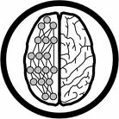
How do ANNs work?
An artificial neural network (ANN) is either a hardware implementation or a computer program which strives to simulate the information processing capabilities of its biological exemplar. ANNs are typically composed of a great number of interconnected artificial neurons. The artificial neurons are simplified models of their biological counterparts.
ANN is a technique for solving problems by constructing software that works like our brains.

Slide 10
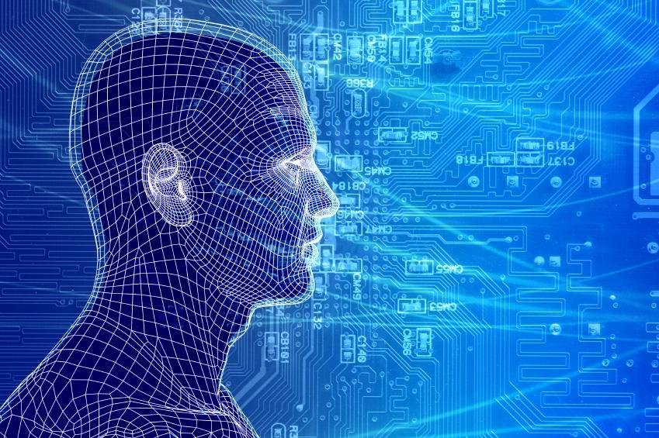
How do our brains work?
The Brain is A massively parallel information processing system.
Our brains are a huge network of processing elements. A typical brain contains a network of 10 billion neurons.

Slide 11
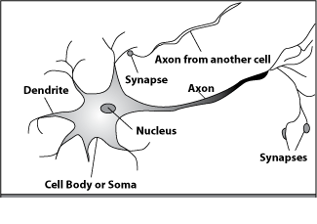
How do our brains work?
A processing element
Dendrites: Input
Cell body: Processor
Synaptic: Link
Axon: Output

Slide 12
How do our brains work?
A processing element
A neuron is connected to other neurons through about 10,000 synapses

Slide 13
How do our brains work?
A processing element
A neuron receives input from other neurons. Inputs are combined.

Slide 14
How do our brains work?
A processing element
Once input exceeds a critical level, the neuron discharges a spike ‐ an electrical pulse that travels from the body, down the axon, to the next neuron(s)

Slide 15
How do our brains work?
A processing element
The axon endings almost touch the dendrites or cell body of the next neuron.

Slide 16
How do our brains work?
A processing element
Transmission of an electrical signal from one neuron to the next is effected by neurotransmitters.

Slide 17
How do our brains work?
A processing element
Neurotransmitters are chemicals which are released from the first neuron and which bind to the
Second.

Slide 18
How do our brains work?
A processing element
This link is called a synapse. The strength of the signal that reaches the next neuron depends on factors such as the amount of neurotransmitter available.

Slide 19
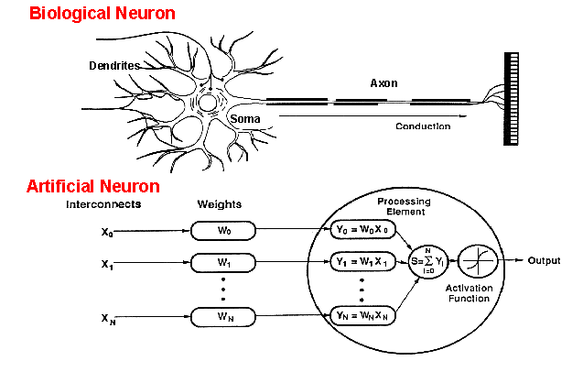
How do ANNs work?
An artificial neuron is an imitation of a human neuron

Slide 20
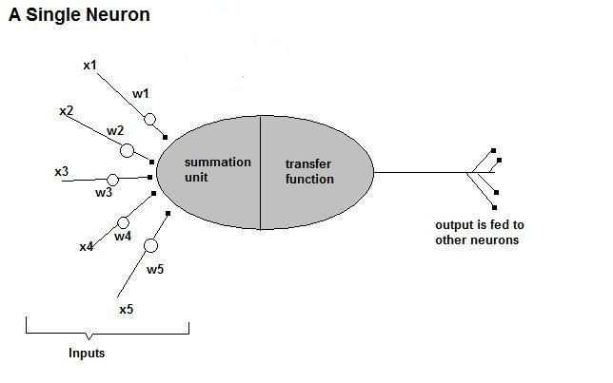
How do ANNs work?
• Now, let us have a look at the model of an artificial neuron.

Slide 21
How do ANNs work?
Input
xm
. . . . . . . . . . . .
x2
x1
Processing
∑
∑= X₁+X₂ + ….+X_{m} =y
Output
y

Slide 22

How do ANNs work?
Not all inputs are equal
xm
. . . . . . . . . . . .
x2
x1
Input
w_{m}
w₂
w₁
weights
. . . . .
Processing
∑
∑= X₁w₁+X₂w₂ + ….+X_{m}w_{m} =y
Output
y

Slide 23

How do ANNs work?
The signal is not passed down to the
next neuron verbatim
xm
. . . . . . . . . . . .
x2
x1
Input
w_{m}
w₂
w₁
weights
. . . . .
Processing
∑
Transfer Function (Activation Function)
f(v_{k})
Output
y

Slide 24
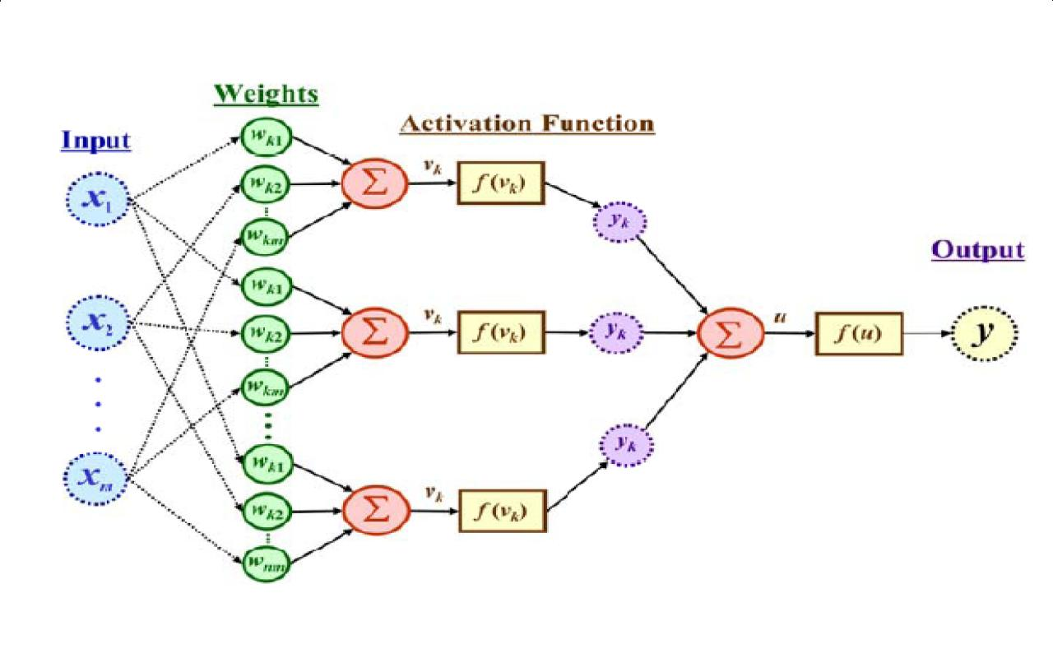
The output is a function of the input, that is affected by the weights, and the transfer functions

Slide 26
Artificial Neural Networks
An ANN can:
compute any computable function, by the appropriate selection of the network topology and weights values.
learn from experience!
Specifically, by trial‐and‐error

Slide 27
Learning by trial‐and‐error
Continuous process of:
Trial:
Processing an input to produce an output (In terms of ANN: Compute the output function of a given input)
Evaluate:
Evaluating this output by comparing the actual output with the expected output.
Adjust:
Adjust the weights.

Slide 30
How it works?
Set initial values of the weights randomly.
Input: truth table of the XOR
Do
Read input (e.g. 0, and 0)
Compute an output (e.g. 0.60543)
Compare it to the expected output. (Diff= 0.60543)
Modify the weights accordingly.
Loop until a condition is met
Condition: certain number of iterations
Condition: error threshold

Slide 31
Design Issues
Initial weights (small random values ∈[‐1,1])
Transfer function (How the inputs and the weights are combined to produce output?)
Error estimation
Weights adjusting
Number of neurons
Data representation
Size of training set

Slide 32
Transfer Functions
Linear: The output is proportional to the total weighted input.
Threshold: The output is set at one of two values, depending on whether the total weighted input is greater than or less than some threshold value.
Non‐linear: The output varies continuously but not linearly as the input changes.

Slide 33
Error Estimation
The root mean square error (RMSE) is a frequently-used measure of the differences between values predicted by a model or an estimator and the values actually observed from the thing being modeled or estimated

Slide 34
Weights Adjusting
After each iteration, weights should be adjusted to minimize the error.
– All possible weights
– Back propagation

Slide 35
Back Propagation
Back-propagation is an example of supervised learning is used at each layer to minimize the error between the layer’s response and the actual data
The error at each hidden layer is an average of the evaluated error
Hidden layer networks are trained this way

Slide 36
Back Propagation
N is a neuron.
N_{w} is one of N’s inputs weights
N_{out} is N’s output.
N_{w} = N_{w} +Δ N_{w}
Δ N_{w} = N_{out} * (1‐ N_{out})* N_{ErrorFactor}
N_{ErrorFactor} = N_{ExpectedOutput} – N_{ActualOutput}
This works only for the last layer, as we can know the actual output, and the expected output.

Slide 37
Number of neurons
Many neurons:
Higher accuracy
Slower
Risk of over‐fitting
Memorizing, rather than understanding
The network will be useless with new problems.
Few neurons:
Lower accuracy
Inability to learn at all
Optimal number.

Slide 38
Data representation
Usually input/output data needs pre‐processing
Pictures
Pixel intensity
Text:
A pattern

Slide 39
Size of training set
No one‐fits‐all formula
Over fitting can occur if a “good” training set is not chosen
What constitutes a “good” training set?
Samples must represent the general population.
Samples must contain members of each class.
Samples in each class must contain a wide range of variations or noise effect.
The size of the training set is related to the number of hidden neurons

Slide 40
Learning Paradigms
Supervised learning
Unsupervised learning
Reinforcement learning

Slide 41
Supervised learning
This is what we have seen so far!
A network is fed with a set of training samples (inputs and corresponding output), and it uses these samples to learn the general relationship between the inputs and the outputs.
This relationship is represented by the values of the weights of the trained network.

Slide 42
Unsupervised learning
No desired output is associated with the training data!
Faster than supervised learning
Used to find out structures within data:
Clustering
Compression

Slide 43

ImageNet vs. PlacesNet
http://places2.csail.mit.edu/demo.html
ImageNet
~1 mil object-level images over 1000 classes
PlacesNet
~1.8 million images from 365 scene categories (at most 5000 images per category).
Notes:
Vs SUN 397, which had at least 100 images in each of 397 classes
‹#›

Slide 44
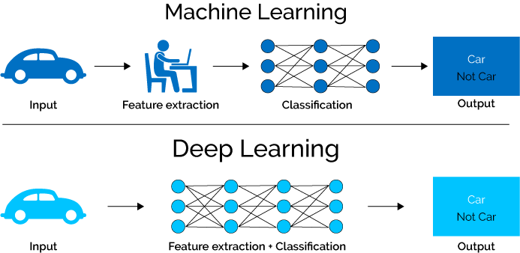
ML vs. Deep Learning
Introduction to Deep Learning
Deep learning (DL) is a machine learning subfield that uses multiple layers for learning data representations
DL is exceptionally effective at learning patterns
Picture from: https://www.xenonstack.com/blog/static/public/uploads/media/machine-learning-vs-deep-learning.png
Notes:
‹#›

Slide 45

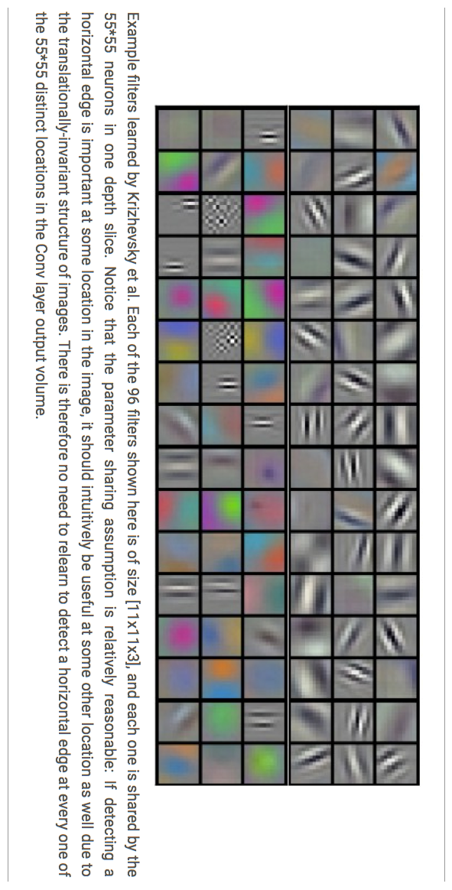

















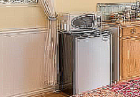

ML vs. Deep Learning
Introduction to Deep Learning
DL applies a multi-layer process for learning rich hierarchical features (i.e., data representations)
Input image pixels → Edges → Textures → Parts → Objects
Low-Level Features
Mid-Level Features
High-Level Features
Trainable Classifier
Output
Slide credit: Param Vir Singh – Deep Learning
Notes:
‹#›

Slide 46
Why is DL Useful?
Introduction to Deep Learning
DL provides a flexible, learnable framework for representing visual, text, linguistic information
Can learn in supervised and unsupervised manner
DL represents an effective end-to-end learning system
Requires large amounts of training data
Since about 2010, DL has outperformed other ML techniques
First in vision and speech, then NLP, and other applications

Slide 47
Reinforcement learning
Like supervised learning, but:
Weights adjusting is not directly related to the error value.
The error value is used to randomly, shuffle weights!
Relatively slow learning due to ‘randomness’.

Slide 48
Applications Areas
Function approximation
including time series prediction and modeling.
Classification
including patterns and sequences recognition, novelty detection and sequential decision making.
(radar systems, face identification, handwritten text recognition)
Data processing
including filtering, clustering blinds source separation and compression.
(data mining, e-mail Spam filtering)

Slide 49
Advantages / Disadvantages
Advantages
Adapt to unknown situations
Powerful, it can model complex functions.
Ease of use, learns by example, and very little user domain‐specific expertise needed
Disadvantages
Forgets
Not exact
Large complexity of the network structure

Slide 50
Conclusion
Artificial Neural Networks are an imitation of the biological neural networks, but much simpler ones.
The computing would have a lot to gain from neural networks. Their ability to learn by example makes them very flexible and powerful furthermore there is need to device an algorithm in order to perform a specific task.

Slide 51
Conclusion
Neural networks also contributes to area of research such a neurology and psychology. They are regularly used to model parts of living organizations and to investigate the internal mechanisms of the brain.
Many factors affect the performance of ANNs, such as the transfer functions, size of training sample, network topology, weights adjusting algorithm, …

Slide 52
References
Craig Heller, and David Sadava, Life: The Science of Biology, fifth edition, Sinauer Associates, INC, USA, 1998.
Introduction to Artificial Neural Networks, Nicolas Galoppo von Borries
Tom M. Mitchell, Machine Learning, WCB McGraw-Hill, Boston, 1997.

Slide 53
Thank You

Slide 54
Q. How does each neuron work in ANNS? What is back propagation?
A neuron: receives input from many other neurons;
changes its internal state (activation) based on the current input;
sends one output signal to many other neurons, possibly including its input neurons (ANN is recurrent network).
Back-propagation is a type of supervised learning, used at each layer to minimize the error between the layer’s response and the actual data.

